Slide 1
Analysis on World Happiness Index
By Yagna Dheepika Venkitasamy

Slide 2

The Report
The World Happiness Report is a landmark survey of the state of global happiness by United Nations that ranks 156 countries by how happy their citizens perceive themselves to be.

Slide 3
Factors Influencing Happiness…
Economy (GDP per Capita)
Family (Social Support)
Health (Life Expectancy)
Freedom of Life Choices
Trust (Perception on Government Corruption)
Generosity

Slide 4
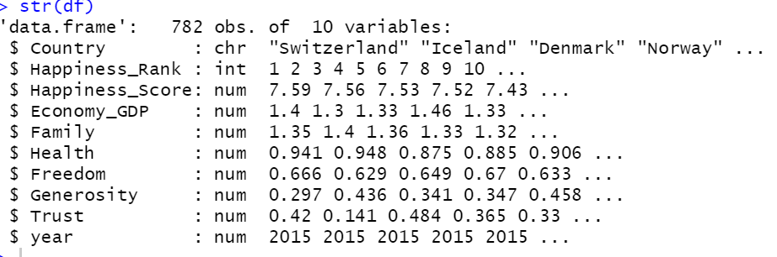
Structure of the dataset..

Slide 5
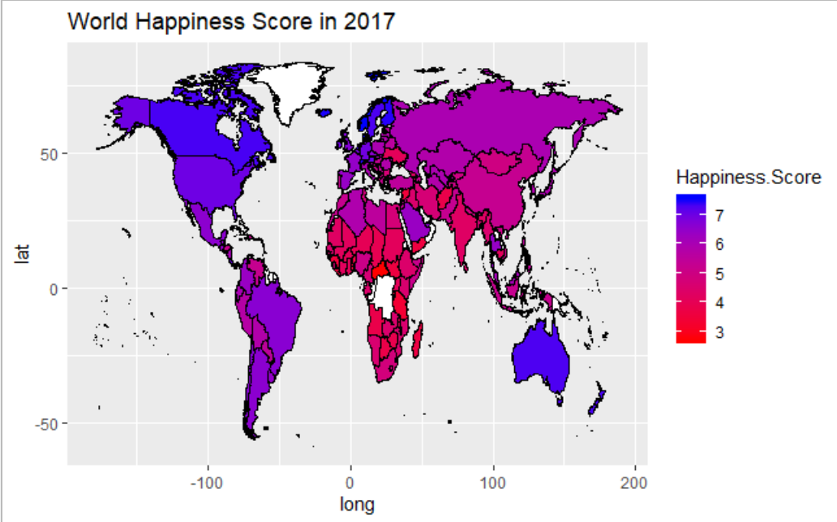

Slide 6
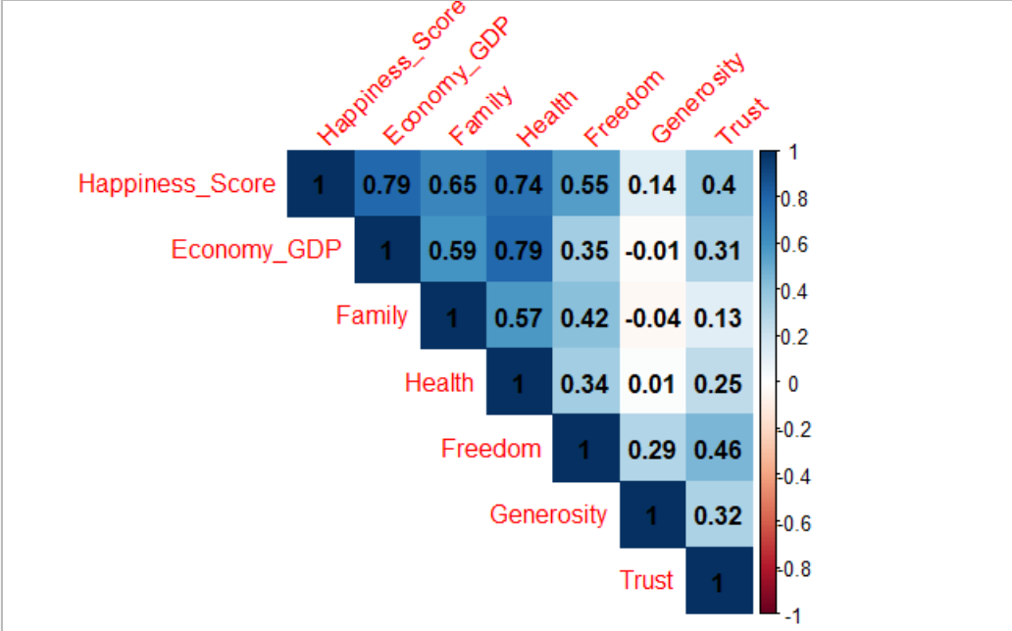
Correlation Matrix

Slide 7
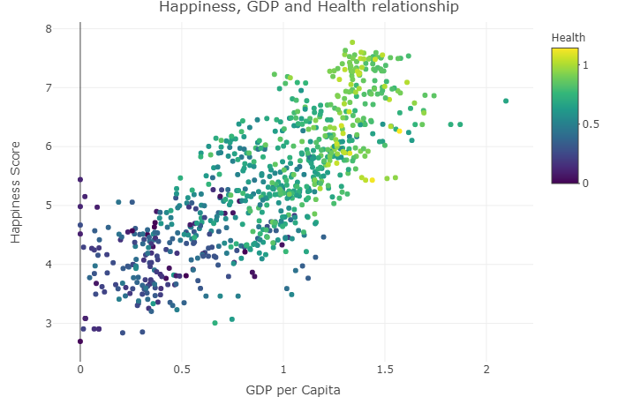

Slide 8
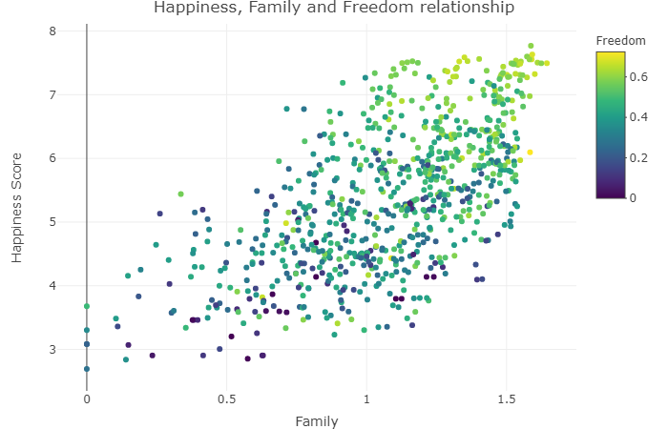

Slide 9
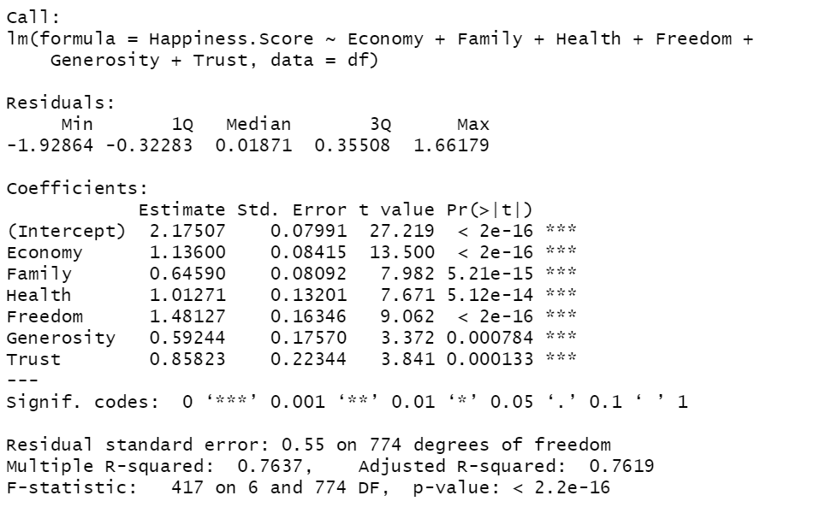
Model 1

Slide 10
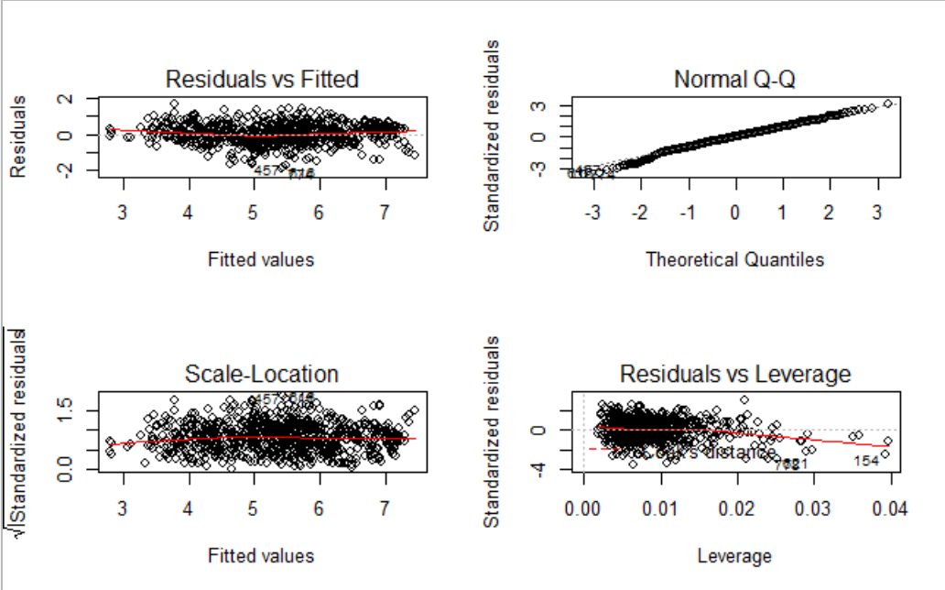

Slide 11
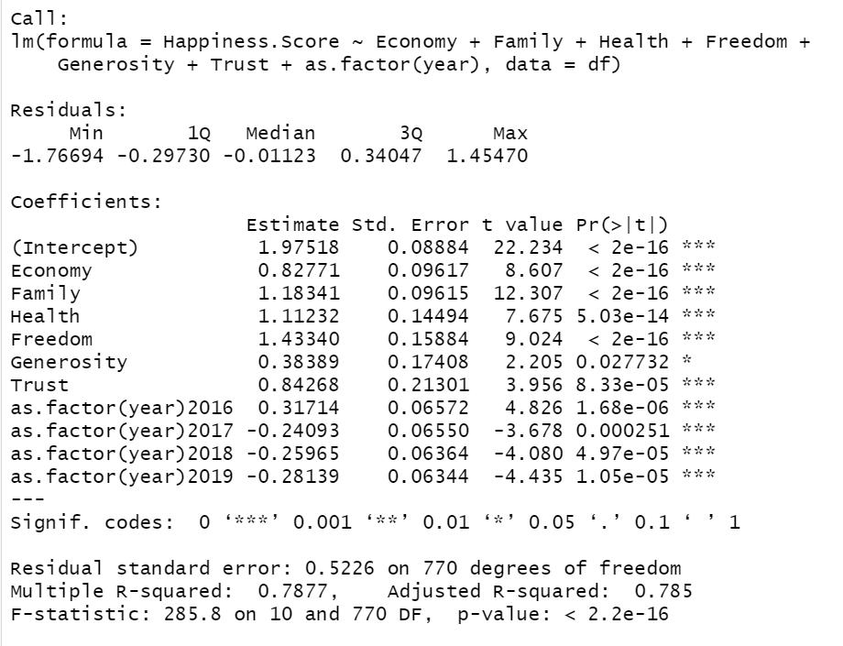
Model 2

Slide 12
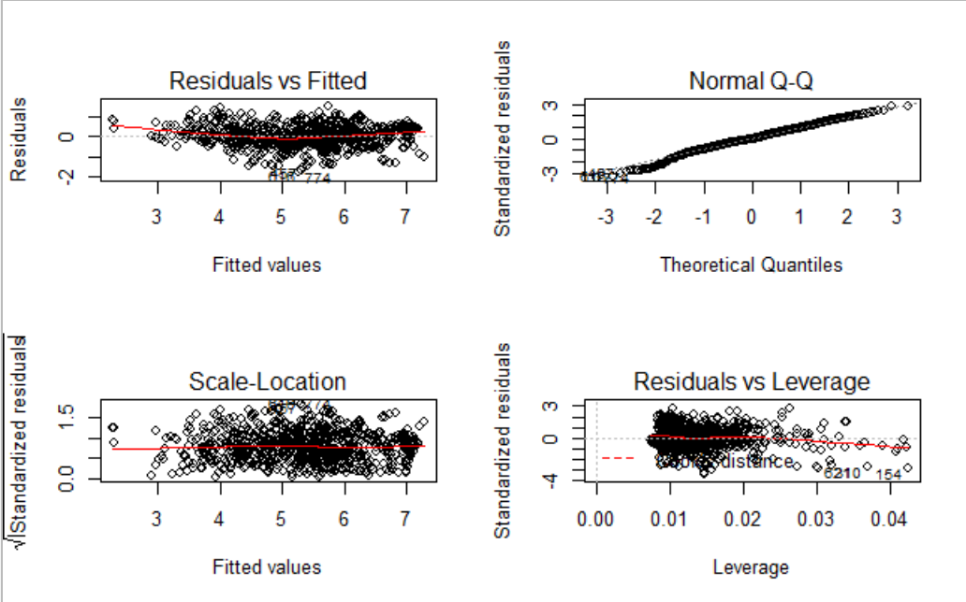

Slide 13
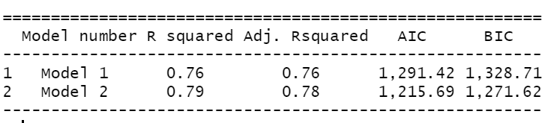
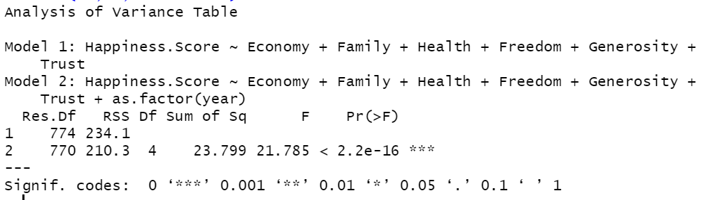
Model 1 vs Model 2

Slide 14
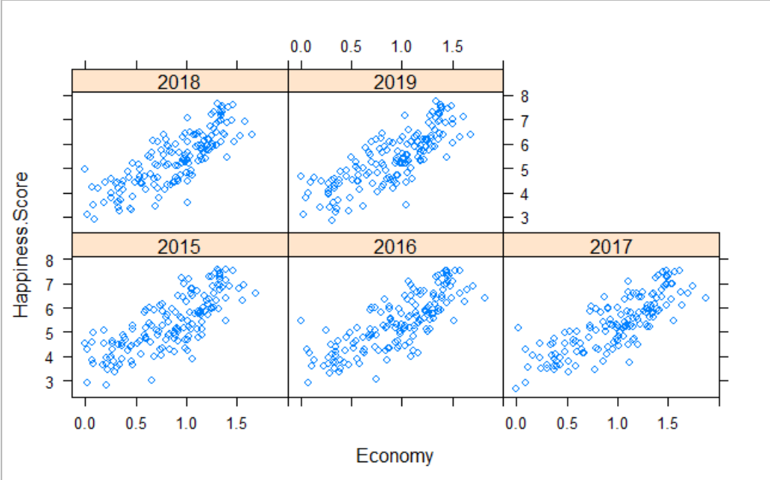
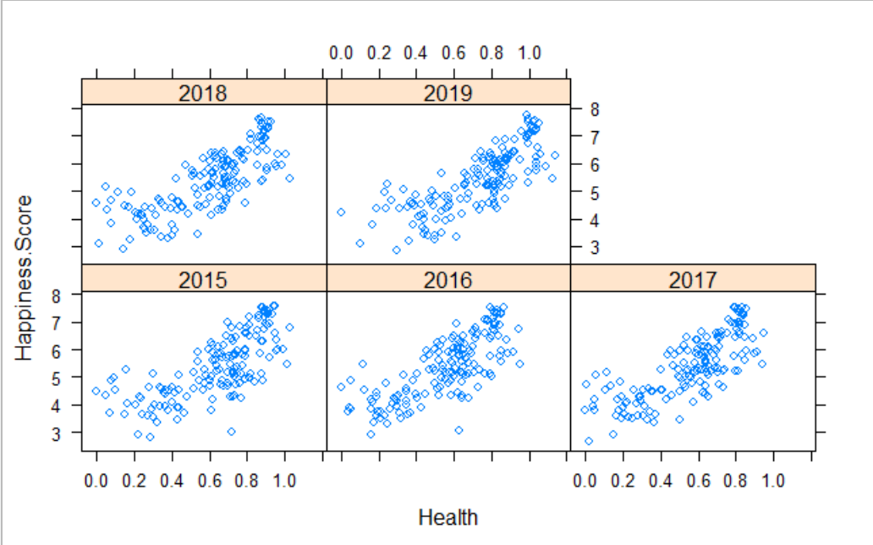
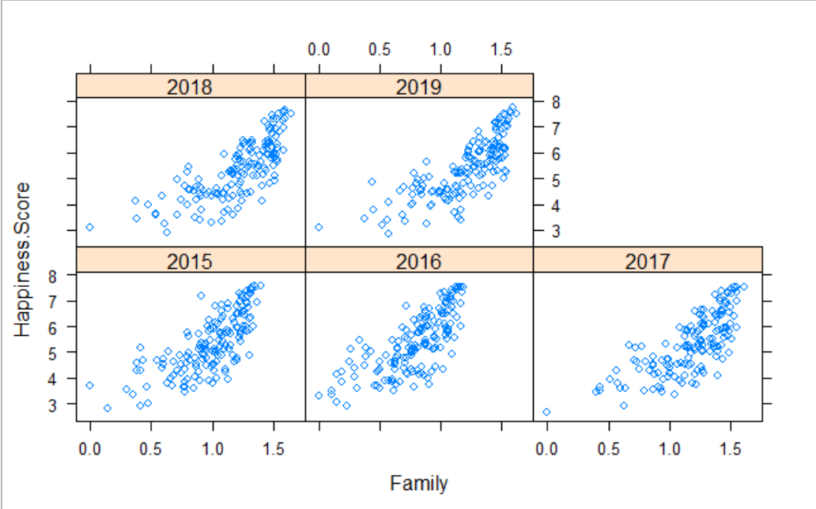
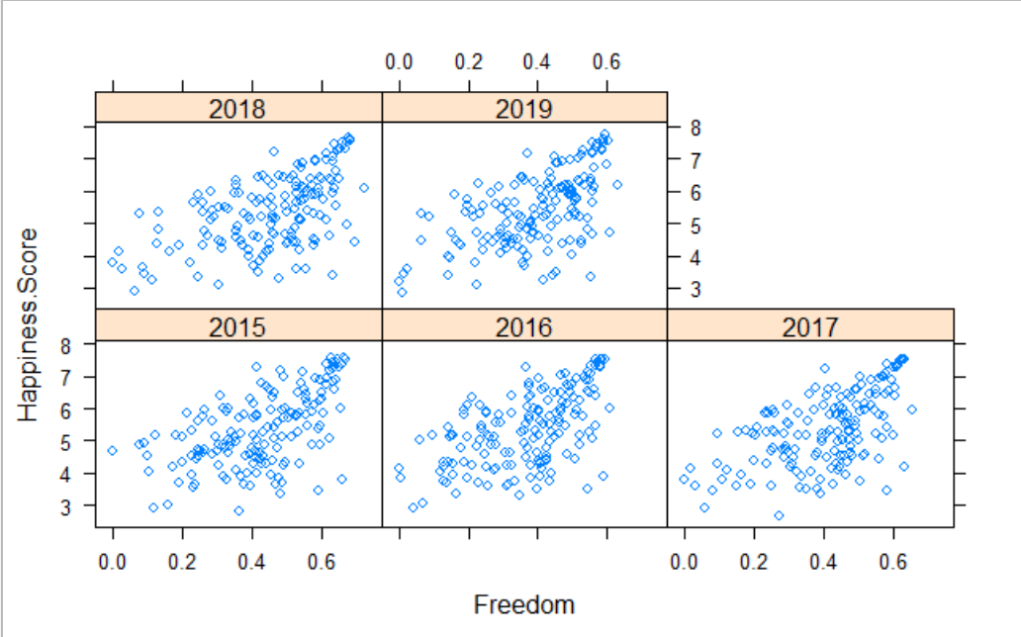
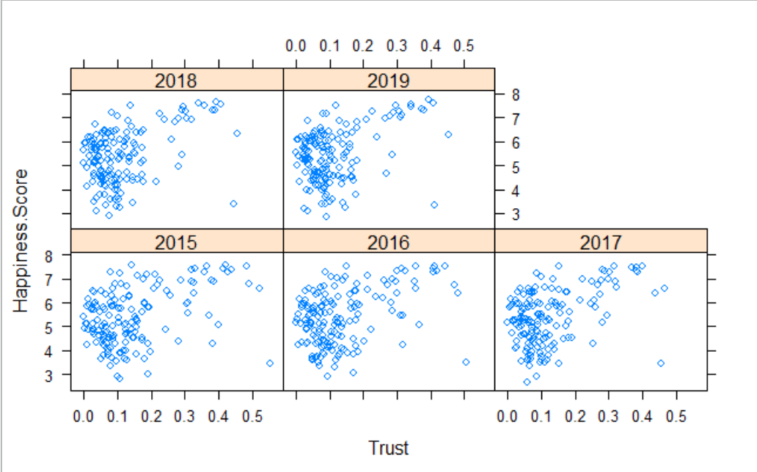
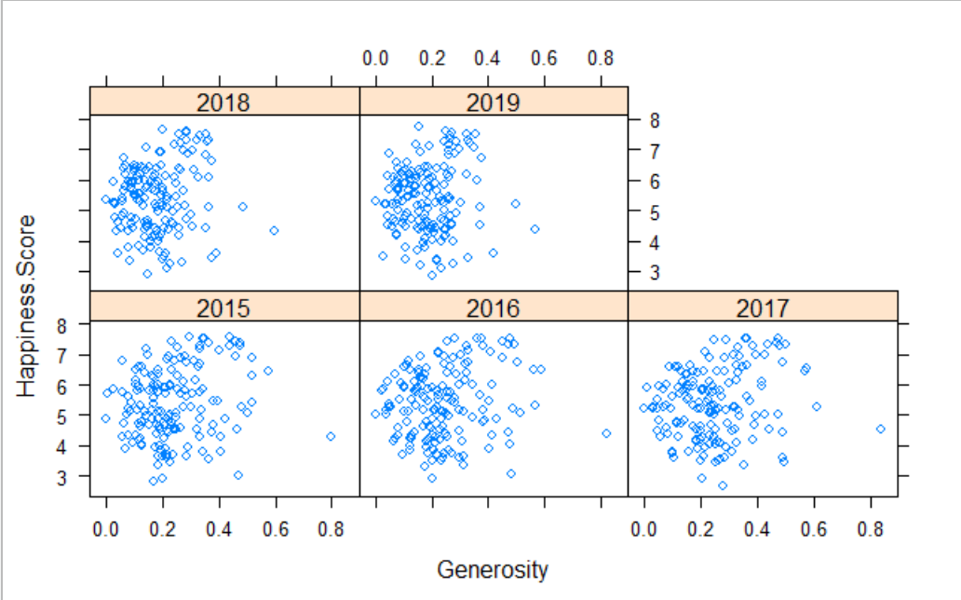

Slide 15
Thank you

